Slide 1


Department of Computer Science And Engineering
Project Work Phase – I
Zeroth Review
Smart LMS with AI-Powered Student Engagement
Batch Members:
Atharsh bharathkumar – 727723EUCS027
Bavanikaa A S – 727723EUCS032
Abishek K S – 727723EUCS003
Harene M – 727723EUCS069
Batch No.: 7
Supervisor: Ms. Nandhini N

Slide 2

Problem Statement
Current Challenges
Educational activities are distributed across multiple platforms.
Teachers find it difficult to monitor students during online classes and ensure active participation.
There is no effective way to identify students who are absent or engaged in unrelated activities.
Student achievements in assignments, projects, sports, and extracurricular activities are not centrally tracked. This reduces motivation and makes it difficult for teachers to recognize deserving students.
Need
Develop a single AI-powered educational ecosystem that integrates learning management, online classrooms, academic tracking, and intelligent engagement analytics.

Slide 3
Objective
Primary Objective
Develop an AI-powered Learning Management System that unifies academic management and online learning.
Enhance student engagement through AI-assisted classroom monitoring and intelligent learning analytics.
Secondary Objectives
Provide a centralized platform for students, teachers, parents, and administrators.
Improve classroom management through AI-based engagement analytics.
Simplify assignment, attendance, and examination management.
Support future AI-assisted learning features.
Expected Outcome
An intelligent educational platform that improves learning efficiency, engagement, and academic monitoring.

Slide 4
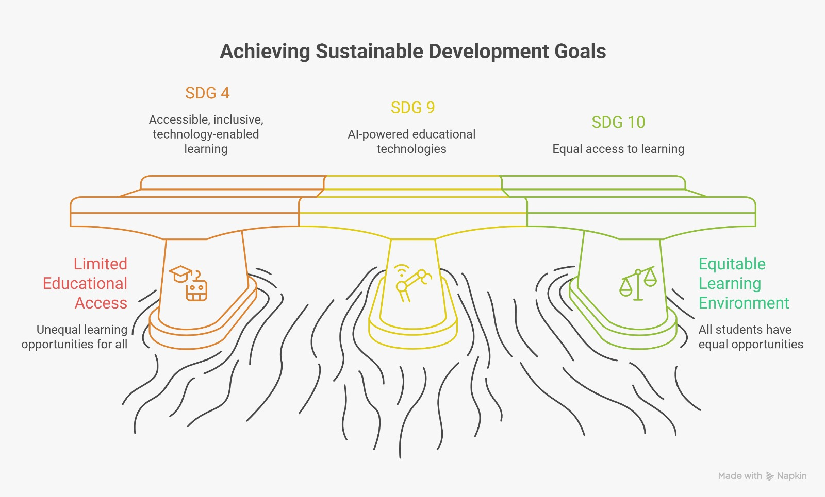
Sustainable Development Goals - Mapping

Slide 5
Literature Review
Previous Work
Existing LMS platforms such as Moodle, Google Classroom, and Canvas provide course management but lack intelligent engagement monitoring.
Research Gap
Current solutions do not integrate Learning Management, Online Classrooms, Computer Vision, Learning Analytics, and AI assistance into a single platform.
Key References
MDPI Electronics (2024)
Springer Learning Analytics (2024)
IEEE Access (2024)
face-api.js (TinyFaceDetector CNN)
WebRTC peer-to-peer video

Slide 6
Existing Technology
Current Technologies
Moodle
Google Classroom
Microsoft Teams
Canvas LMS
Zoom
Limitations
Separate platforms for different academic activities.
Limited AI-based engagement analysis.
Lack of integrated learning analytics.
Minimal support for intelligent classroom monitoring.
Technology Trend
Artificial Intelligence, Computer Vision, Learning Analytics, and Multimodal Student Engagement Systems.

Slide 7
Proposed Work/ Methodology
Concept
Develop an AI-powered educational ecosystem combining LMS, Online Classroom, and Learning Analytics.
Innovation
Integrated academic platform
Browser-based CNN face detection
Computer Vision-based engagement analytics
Attendance derived from class attention
Unified dashboards for Students, Teachers, Parents, and Admins .
Technology Stack
React.js
Spring Boot (Java 17)
H2 / MySQL
JavaScript
Tailwind CSS
face-api.js
WebRTC

Slide 8
Expected Outcomes
Results
Unified educational platform
Improved classroom management
Better student engagement
Centralized academic records
Benefits
Reduced administrative workload
Better learning analytics
Real-time engagement monitoring
Improved communication among stakeholders
Applications
Schools
Colleges
Universities
Online Learning Platforms

Slide 9
Budget
Cost Breakdown:
• UI/UX Design – ₹5,000
• Web application development – ₹15,000
• Database & hosting – ₹3,000
• Testing & Deployment – ₹2,000
Total Estimated Cost – ₹25,000
Resources Needed:
• Laptop/Desktop
• Internet Connection
• VS Code / IntelliJ IDEA
• H2 / MySQL database
• Webcam for proctoring tests
Funding Sources:
• College Project Fund
• Hackathon Grants
• Institutional Support
• Self-Funding by Team Members

Slide 10
Reference(s)
References
Ramírez Ruiz, J.J., Vargas Sánchez, A.D., & Boude Figueredo, O.R. (2024). Impact of Gamification on School Engagement: A Systematic Review. Frontiers in Education.
Kouyate, A., Rashid, N.A., & Mohamed, F.A. (2025). Gamification and Reward Systems for Enhancing Student Involvement in Extracurricular Activities at Universities. INTI Journal.
Pechenkina, E. (2017). Developing a Typology of Mobile Apps in Higher Education: A National Case Study. Australasian Journal of Educational Technology.
Tang, H.T., & Shen, L.S. (2025). Peer Collaborative Learning and Academic Engagement in University Libraries. Frontiers in Psychology.
Xu, Z., Choudhury, F.H., Ma, S., Murphrey, T.P., & Dooley, K.E. (2025). Leveraging Learning Analytics to Model Student Engagement. Behavioral Sciences.

